Slide 1





SWARM SHOOTERS
Lego EV3
Gold Final Presentation
Explore
18/01/2023

Slide 2
Team Presentation
Xinzhuo Wang : Project Manager
Yassine BOUHLEL : Hardware Engineer
Mike GBADAMASSI : Software Engineer
Saisri CHANDANA : Test and Validation Engineer
Rijesh THAYATHIDATH : Documentation Engineer
Explore
………………………………………………………………………………………………………………………

Slide 3
Context :
General Architecture
Hardware design
Software solution
Test demonstration
Results
Explore
………………………………………………………………………………………………………………………

Slide 4



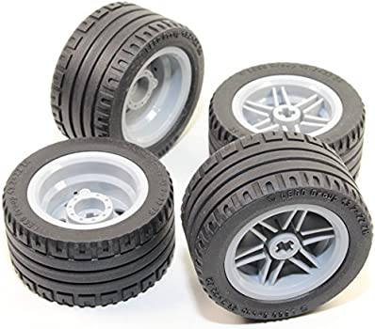
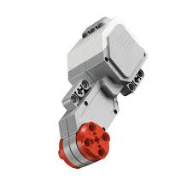
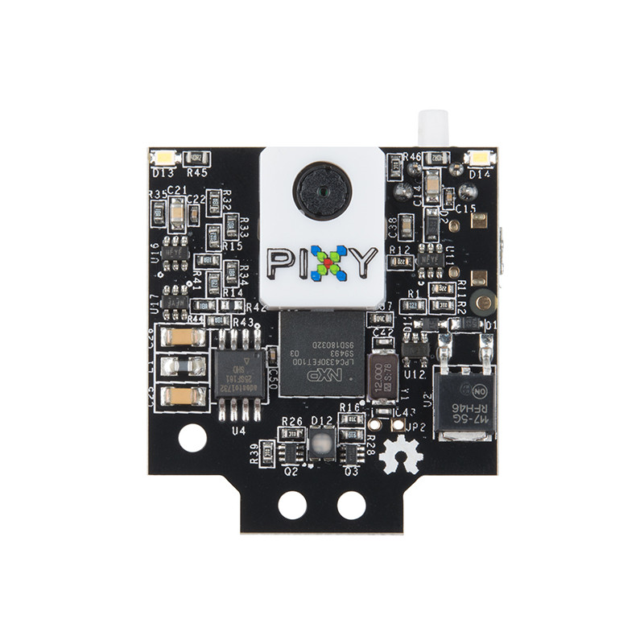
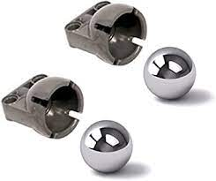

General Architecture
Specification/functions :
The Slave will move in predefined pattern
The Slave will detect a flying anti drone object and shares information to Master
Master calculates distance and commands to shoot
Slave shoots the flying target
DESIGN COMPONENTS:
2 Rare wheels 4 Motors Pixy camera 1 Idler wheel
Explore

Slide 5
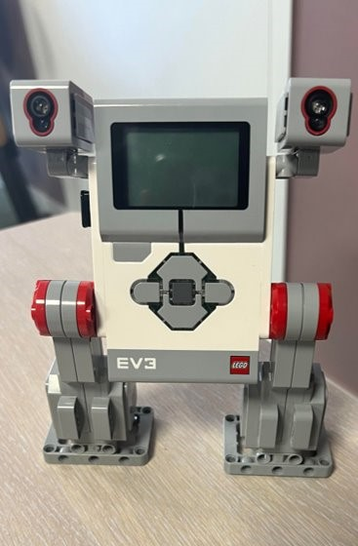
Hardware Design:
Master robot
Master robot :
Main board (Lego EV3)
Communication module (Wifi dongle)
Here we are using EV3 brick which serves as the control center and power station for the robot
To connect two bricks we are using WiFi dongles that allow communication at longer distances and wirelessly
Master is the host in socket connection for communication between robots

Slide 6
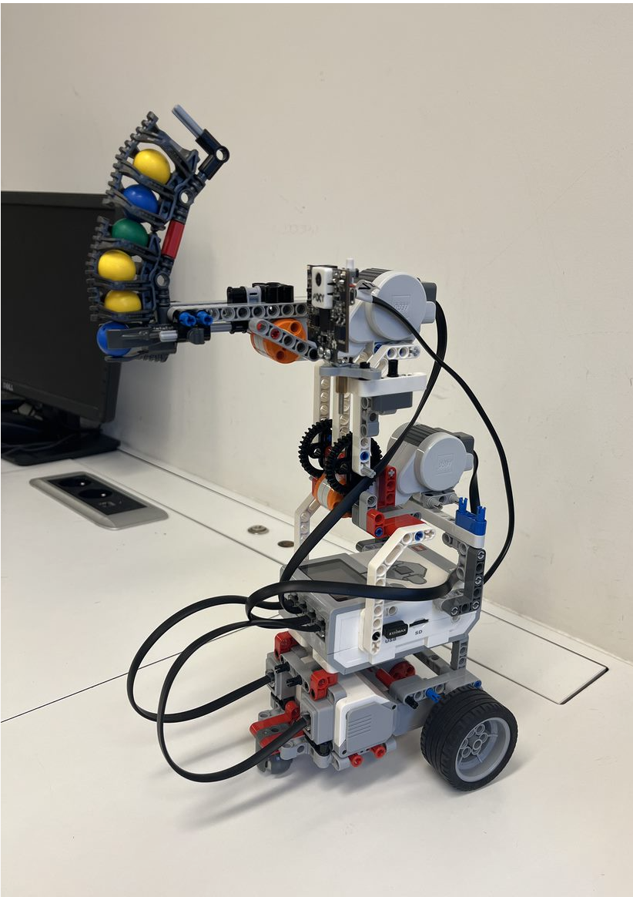
Hardware Design:
Slave robot
Slave robot: EV3 Brick, Wifi dongle ,wheels, pixy camera, shooter, Large serving Motors
Here we are using EV3 brick which Serves as the control center and power station for the robot.
To connect two bricks we are using WiFi dongles allows communication at longer distances.
For slave robot we are using 4 EV3 large motors which had built in rotation motor for wheels, elevation of camera and for the shooting part.
Pixy camera is primarily a color sensor,a highly optimized and specialized sensor here We chose Red and Yellow as target colors.

Slide 7

Software Solution
File main.py
Class Slave Bot
Moving pattern function
Pixy Camera function
Shooting function
Ballistic_shoot function
Odometrium Class
File main_master.py
Class Master Bot
Server connection function
distance_calculation function
Receive_info function
Use of Threading for moving pattern function and Pixy Camera function, others functions are called inside theses two ones
Socket python used for connection between Slave & Master Robot, with Wi-Fi
Explore

Slide 8

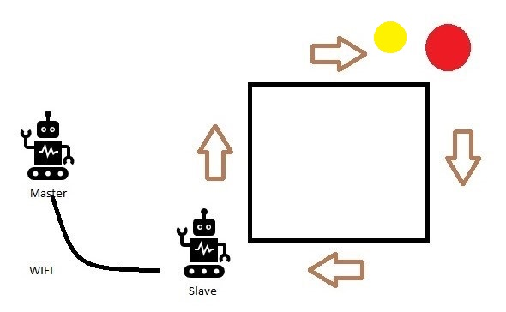

Test Conditions
There are 2 robots : Slave & Master
The area is a square on the ground of 1x1 Meters, next to a wall.
Slave robot moves in this predefined pattern
The target object (a red or yellow ball/square) can be fixed on the wall (or in the sky, held by hand) : distance between the target and the robot to be measured during the test
The robot starts at on corner of the square
Slave covers the square area and scans for the target with the Pixy camera
When the targets are detected by Slave, information is sent to the Master who calculates the distance, prioritizes the targets and sends back the information to shoot to the slave.
Slave shoots after receiving message from Master shoots the closest of the target, after centering the target (elevation and orientation)

Slide 9
Test Verifications
The Slave should move (with pattern of 1x1m square) and scan the sky.
When the target objects are detected :
The Slave stops and tells target detected and shares information to the Master
Master calculates the distance of the targets, tells it and shows it on the screen / on terminal computer
Slave robot discriminates and prioritizes targets and shoots the target considering its altitude (elevation) and orientation and shoots the closest one first (then it focuses on the second target)
Master sends the order to shoot to Slave and slave shoots the target
Slave continues to move in the original pattern, while scanning the sky
Robots will handle the case where a robot breaks down, loses his connection to the network and reconnects.

Slide 10
Problems Encountered
Slave robot should move (with pattern of 1x1m square) but making it turn exact 90 degrees is the first problem so to over come this we did some changes in code for the perfect 90 degree turn (as much as possible).
SSH and wireless connection to launch the code
=> Now : wireless launch and SSH connection done
Establishing connection between Master&Slave

Slide 11
Results and choices

Slide 12

THANK YOU !

